Slide 1
ESP 8266
Workshop
VERDANA

Slide 2

ESP 8266
Text

Slide 3
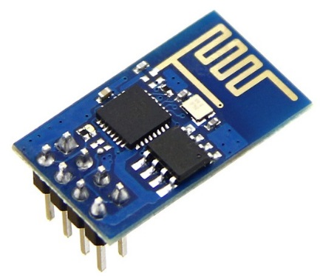
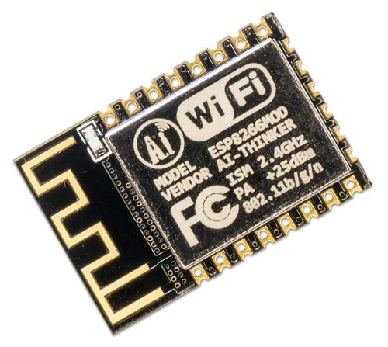
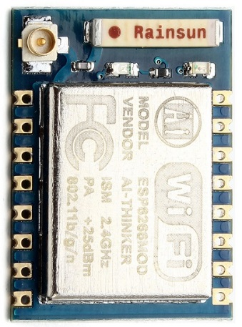
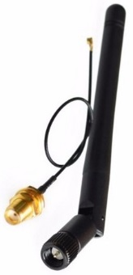
ESP 8266 | Recommended Types
ESP-01 | ESP-12e/f | ESP-07
Small 512 kB memory 2 GPIO Integrated antenna | Soldering needed 4 MB memory 17 GPIO (half with predefined purpose) Deep sleep mode Integrated antenna | Similar to ESP-12 Soldering needed 4 MB memory 9 GPIO (half with predefined purpose) Deep sleep mode External antenna needed

Slide 4
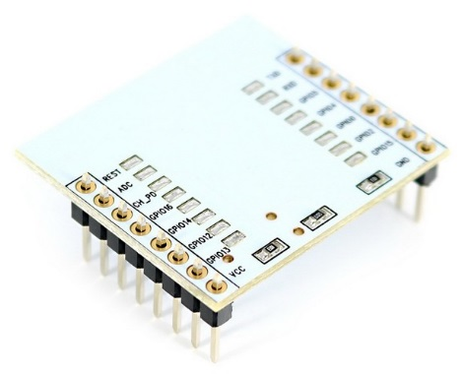
Shopping List 1/3
ESP 8266 | ESP-01 | ESP 8266 | ESP-12e / 12f | ESP-12 adapter
4 GPIO 512 kB memory WiFi | 17 GPIO 4 MB memory Pin for wake up from deep sleep WiFi | Suitable for ESP-12e/f Adapter for ESP-12e/f not available yet → some pins not connected.
1.65 USD | 1.80 USD 2.70 USD (with adapter) | 0.65 USD
Can be ordered on: https://www.aliexpress.com/ Prices include shipping.

Slide 5
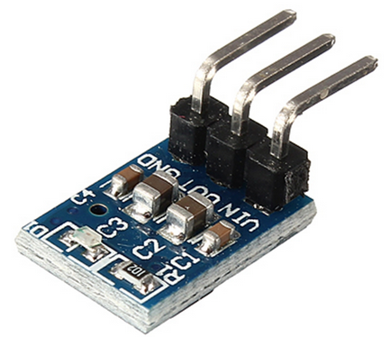
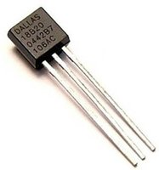
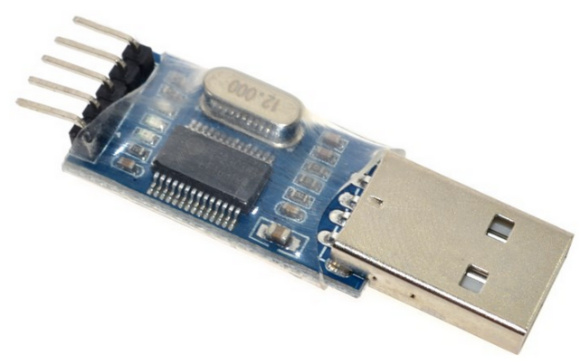
Shopping List 2/3
PL2303 | 5v to 3.3v AMS1117 | DS1820
USB to TTL To communicate (program and flash) with ESP from PC. | DC-DC Step-Down Power Supply Buck Module AMS1117 800mA One for each ESP. | Temperature sensor. It is possible to connect more than one over one wire to the ESP.
0.65 USD | 2.70 USD / 10 pieces | 8.50 USD / 10 pieces 5.90 USD / 5 pieces
Images are not in comparable scale.

Slide 6
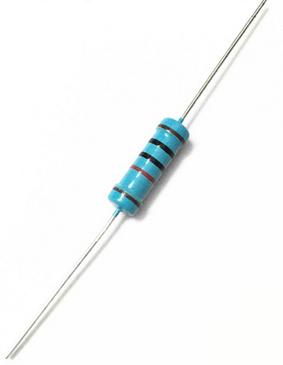
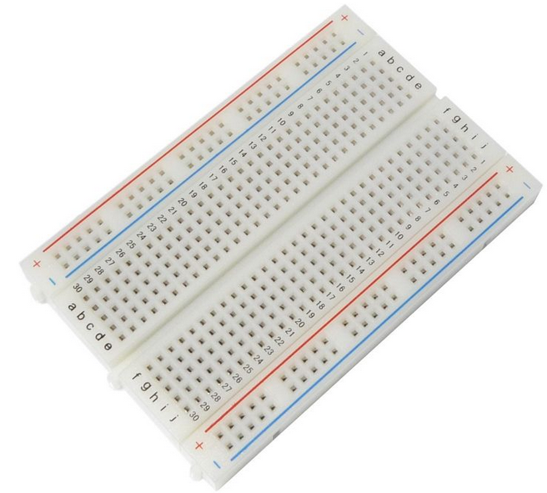
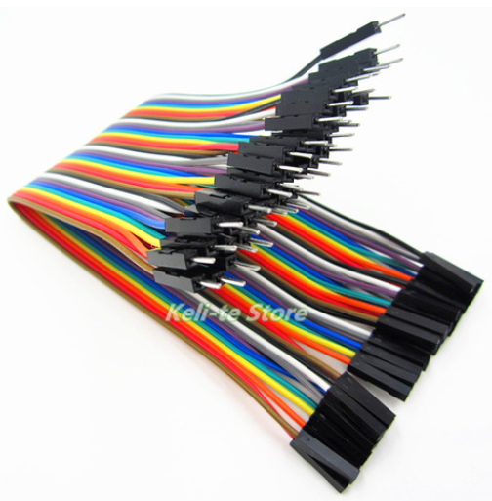
Shopping List 3/3
4,7 k Ohm resistor | Breadboard | Row Dupont Cable
One for each connected DS1820. Buy in GM Electronic (Pilsen), or another electronic shop. | Place to plug all pieces in and connect with wires. | Wires to connect all pieces together. Buy two types: male-to-male and male-to-female.
~ 0 USD | 1.10 – 5.00 USD (depends on size) | 1.00 USD
Images are not in comparable scale.

Slide 7
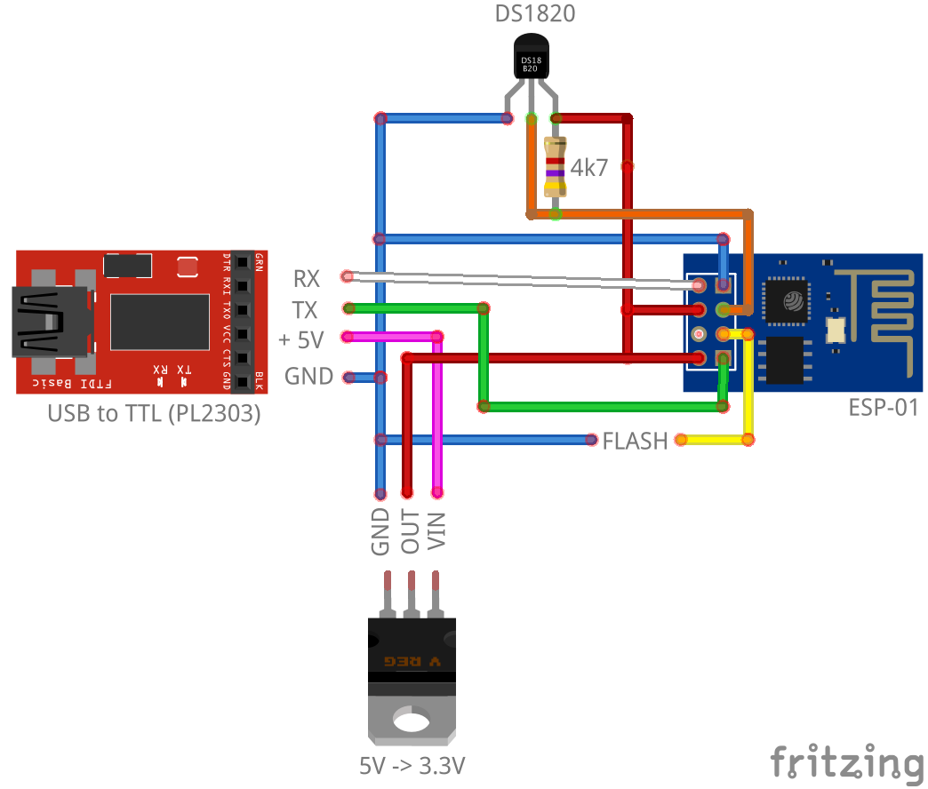
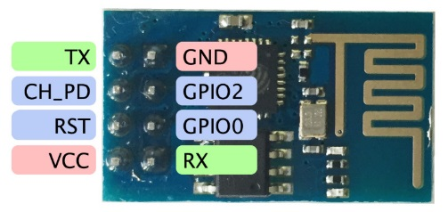
Connection | ESP-01

Slide 8
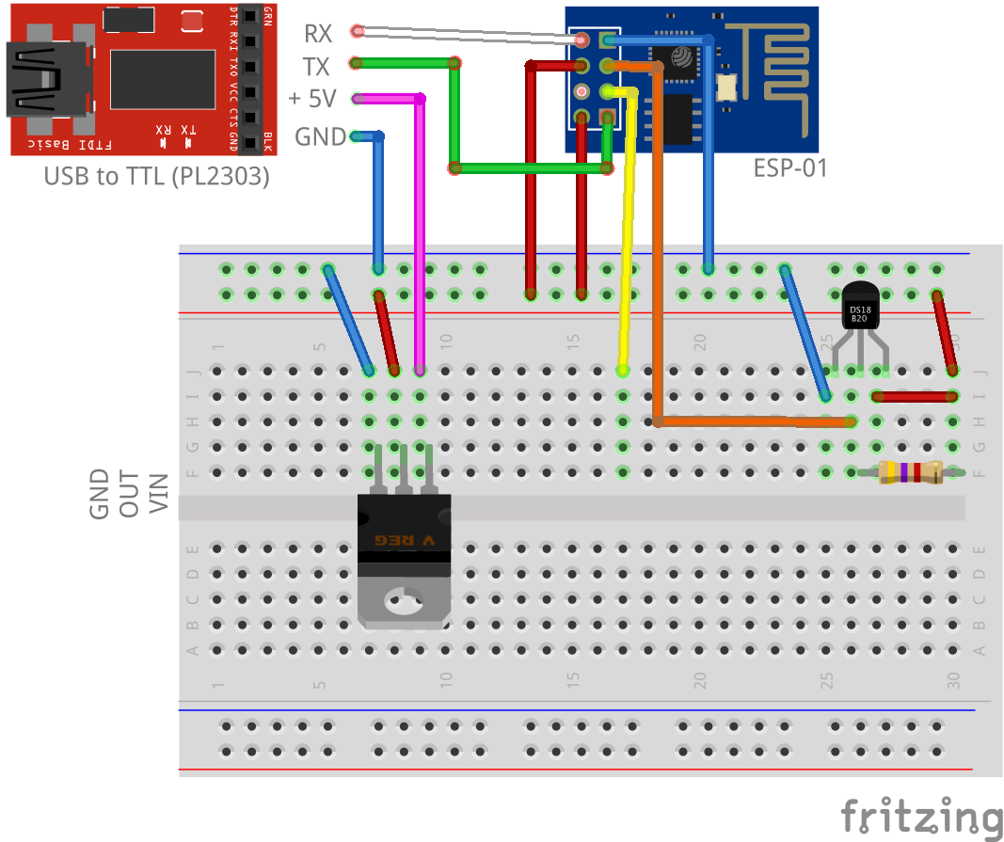
Connection | ESP-01

Slide 9
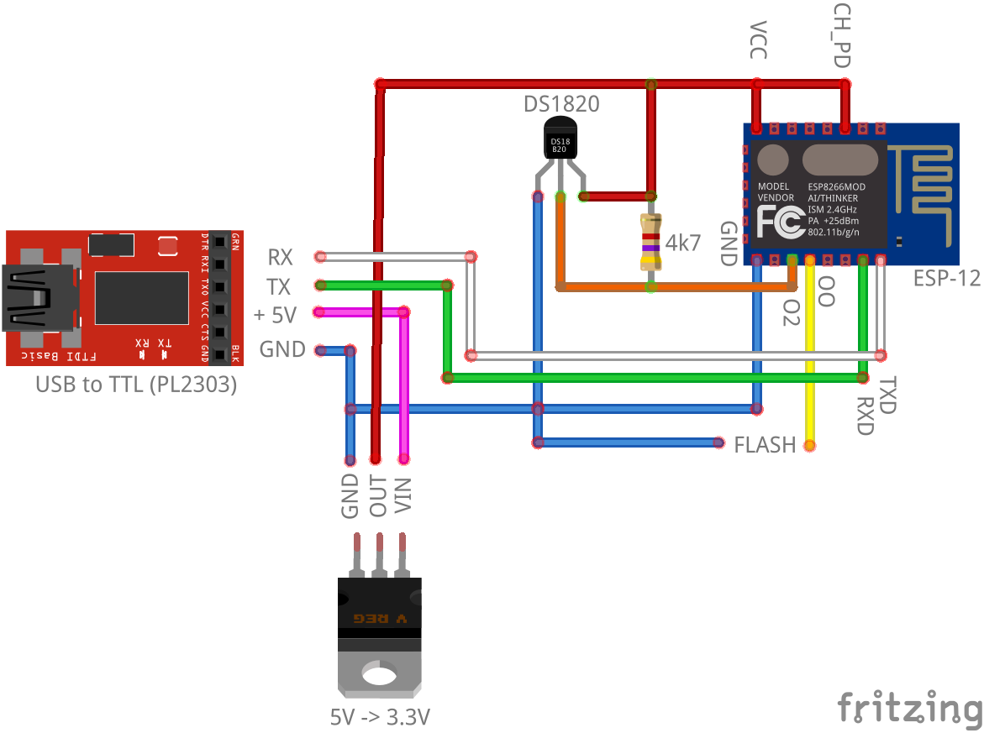
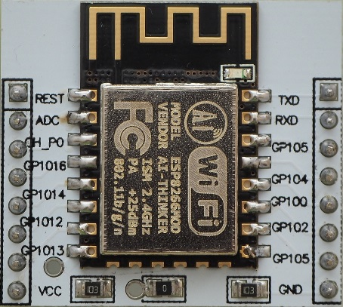
Connection | ESP-12

Slide 10
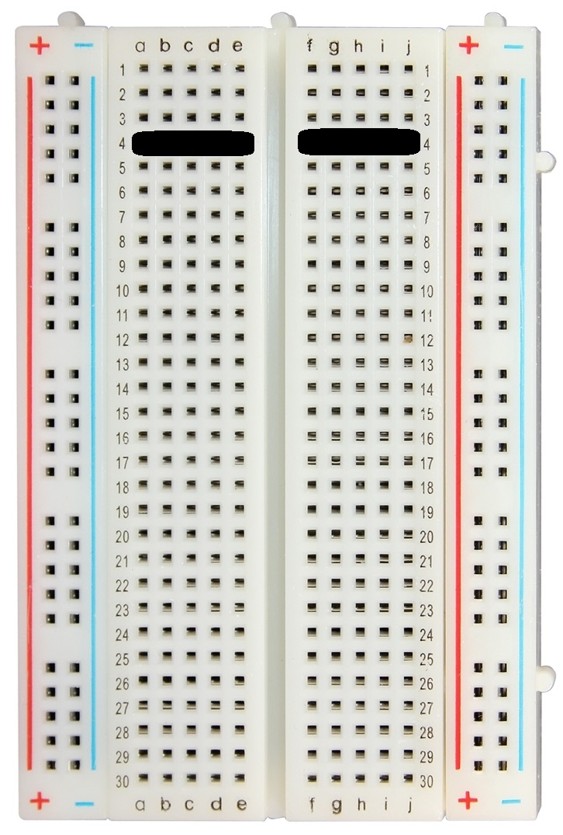
Breadboard
+/- are connected vertically.
+/- from one side is NOT connected to other side.
A-E and F-J are connected horizontally.
A-E is NOT connected to F-J.
Connection example on 4th line

Slide 11
Install on Windows
Text

Slide 12
Install on Mac OS X
Tutorial
https://github.com/nodemcu/nodemcu-devkit/wiki/Getting-Started-on-OSX
Install driver
Install ESPlorer
Install python
Install esptool
Driver:
http://www.prolific.com.tw/US/ShowProduct.aspx?p_id=229&pcid=41

Slide 13
Zarizeni od Jakuba
Text

Slide 14
DS1820 – Temperature
It is possible to connect more DS1820 to one wire connected to one GPIO.

Slide 15
DHT22 – Temperature & Humidity
One DHT22 can be connected to one GPIO

Slide 16
Arduino IDE
Install ESP 8266 support into Arduino IDE:
https://github.com/esp8266/Arduino
Build in + external libraries
https://github.com/esp8266/Arduino/blob/master/doc/libraries.md

Slide 17
Title
Text

